Slide 1
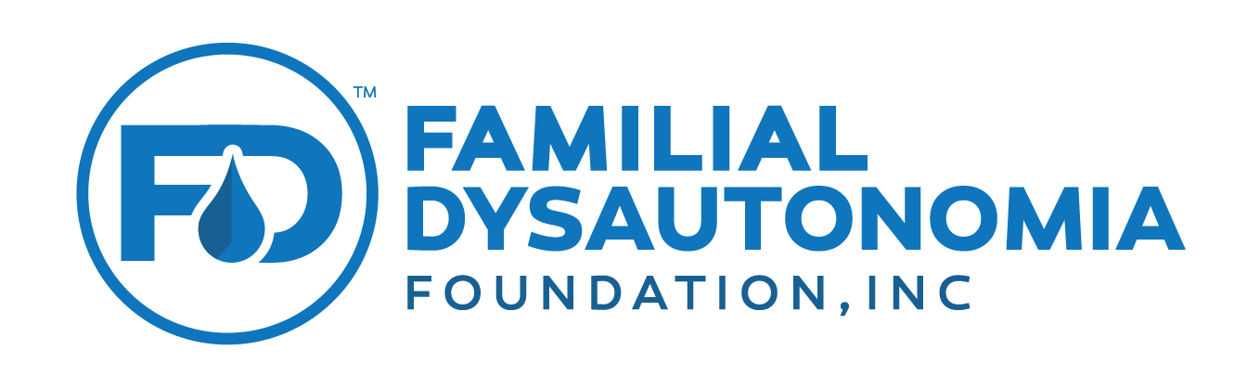

What is it, and how can you participate?
Familial Dysautonomia
Voice of the Patient Forum
Your Role in Drug Development
To be Held on November 5th, 2020
Lanie Etkind James E. Valentine, J.D., M.H.S. &
Robin Landau Larry Bauer, Sr. Regulatory Drug Expert

Slide 2
Lanie Etkind, Executive Director FD Foundation
Purpose of Meeting?
To educate the Food & Drug Administration (FDA)
  What it is like to live with Familial Dysautonomia
  Your concerns as the disease progresses
  How you are currently managing Familial Dysautonomia
  What meaningful treatments look like
Notes:
We will cover in this talk important information about the meeting, your options for participating, including registering for the meeting if you haven’t already.

Slide 3
Robin Landau, FD Volunteer
Why Should I Participate?
  Opportunity to have Your Voices heard
  The FDA approves all treatments for Familial Dysautonomia and needs to know what is important to you
  This knowledge will impact their decision-making, and lead to better treatments and potentially faster approvals for Familial Dysautonomia

Slide 4
Why Now?
The Patient’s Voice has historically been absent from the drug development process
  Until a drug was approved by the FDA (sometimes to treat symptoms not important to patients), or
  A clinical trial was failing and the drug company or FDA wanted input from actual patients to understand the problem
Want your Voices heard at the beginning of the process and throughout
Stakeholder engagement = FDA Priority
  Initiated a Patient Focused Drug Development Program to learn about disease impact on patient’s lives both from patients and their caregivers
Notes:
Give example

Slide 5
Overview
Background on FDA & Drug Development
Introduction to FDA’s Patient-Focused Drug Development
Participating in the Meeting
  Logistics, Format, and Tips
Other Important Information
Questions

Slide 6
Background on FDA and
Drug Development

Slide 7
Drug Discovery
Typically, researchers discover new drugs through:
  New insights into a disease process that allow researchers to design a product to stop or reverse the effects of the disease
  Many tests of molecular compounds to find possible beneficial effects against any of a large number of diseases
  Existing treatments that have unanticipated effects
  New technologies, such as those that provide new ways to target medical products to specific sites within the body or to manipulate genetic material
Once researchers identify a promising compound, the development of drugs follows a well-established path to make sure that they are safe and effective when they reach the public
Notes:
At this stage in the process, thousands of compounds may be potential candidates for development as a medical treatment. After early testing, however, only a small number of compounds look promising and call for further study.

Slide 8
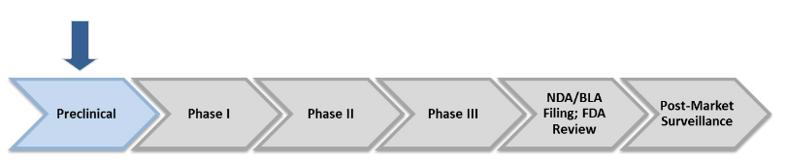
Preclinical Development
Preclinical work occurs before a new drug or biologic is tested in humans
Primary goals are to determine whether the product is
  Reasonably safe for initial use in humans
  Sufficiently effective against a disease target in chemical assay tests or animal models
The end results of the preclinical stage of development is an Investigational New Drug Application (IND)
Notes:
Before testing a drug in people, researchers must find out whether it has the potential to cause serious harm, also called toxicity. The two types of preclinical research are: In Vitro and In Vivo.
FDA requires researchers to use good laboratory practices (GLP), defined in medical product development regulations, for preclinical laboratory studies. These regulations set the minimum basic requirements for:
study conduct
personnel
facilities
equipment
written protocols
operating procedures
study reports
and a system of quality assurance oversight for each study to help assure the safety of FDA-regulated product
Usually, preclinical studies are not very large. However, these studies must provide detailed information on dosing and toxicity levels. After preclinical testing, researchers review their findings and decide whether the drug should be tested in people.

Slide 9
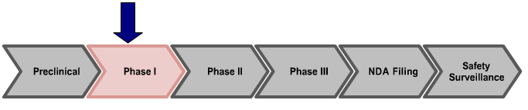
Clinical Development – Phase 1
IND submission
  Pharmacology/Toxicology Studies
  Manufacturing Information
  Clinical Protocols and Investigator Information
Phase 1 primary goals
  Place emphasis on a drug’s safety
  Determine the most common side effects of a drug
  Determine how a drug is metabolized and excreted
Notes:
While preclinical research answers basic questions about a drug’s safety, it is not a substitute for studies of ways the drug will interact with the human body. “Clinical research” refers to studies, or trials, that are done in people. As the developers design the clinical study, they will consider what they want to accomplish for each of the different “clinical research phases” and begin the Investigational New Drug, or IND, process, a process they must go through before clinical research begins.
Drug developers, or sponsors, must submit an Investigational New Drug (IND) application to FDA before beginning clinical research. In the IND application, developers must include:
Animal study data and toxicity (side effects that cause great harm) data
Manufacturing information
Clinical protocols (study plans) for studies to be conducted
Data from any prior human research
Information about the investigator
Here, and throughout the review, the FDA review team consists of a group of specialists in different scientific fields.
Researchers design clinical trials to answer specific research questions related to a medical product. These trials follow a specific study plan, called a protocol, that is developed by the researcher or manufacturer. Before a clinical trial begins, researchers review prior information about the drug to develop research questions and objectives. Then, they decide:
Who qualifies to participate (selection criteria)
How many people will be part of the study
How long the study will last
Whether there will be a control group and other ways to limit research bias
How the drug will be given to patients and at what dosage
What assessments will be conducted, when, and what data will be collected
How the data will be reviewed and analyzed
Clinical trials follow a typical series from early, small-scale, Phase 1 studies to late-stage, large scale, Phase 3 studies.
Patients: 20 to 100 healthy volunteers or people with the disease/condition.
Length of Study: Several months
Purpose: safety and dosage
During Phase 1 studies, researchers test a new drug in normal volunteers (healthy people). In most cases, 20 to 80 healthy volunteers or people with the disease/condition participate in Phase 1. However, if a new drug is intended for use in cancer patients, researchers conduct Phase 1 studies in patients with that type of cancer.
Phase 1 studies are closely monitored and gather information about how a drug interacts with the human body. Researchers adjust dosing schemes based on animal data to find out how much of a drug the body can tolerate and what its acute side effects are.
As a Phase 1 trial continues, researchers answer research questions related to how it works in the body, the side effects associated with increased dosage, and early information about how effective it is to determine how best to administer the drug to limit risks and maximize possible benefits. This is important to the design of Phase 2 studies.

Slide 10
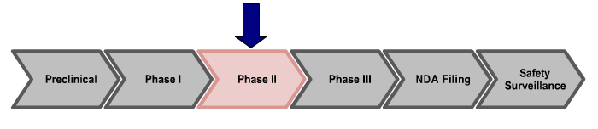
Clinical Development – Phase 2
Primary goals
  Place emphasis on a drug’s effectiveness
  Determine if the drug works in people who have a certain disease
  Compare the drug against placebo
  Continue to monitor short-term side effects and other safety issues
Notes:
Patients: Up to several hundred people with the disease/condition.
Length of Study: Several months to 2 years
Purpose: efficacy and side effects
In Phase 2 studies, researchers administer the drug to a group of patients with the disease or condition for which the drug is being developed. Typically involving a few hundred patients, these studies aren't large enough to show whether the drug will be beneficial.
Instead, Phase 2 studies provide researchers with additional safety data. Researchers use these data to refine research questions, develop research methods, and design new Phase 3 research protocols.
Discuss the importance of “clinical effectiveness” (how a patient feels, functions, or survives) as what FDA is most interested in rather than biomarkers/surrogates

Slide 11
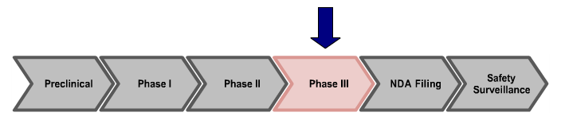
Clinical Development – Phase 3
Primary goals
  Traditionally large-scale, randomized, placebo-controlled trials
  Continued assessment of effectiveness, duration of effect, effect in different populations, varying dosages
  Safety evaluation continues, including potential drug-drug interactions
Notes:
Patients: 300 to 3,000 volunteers who have the disease or condition, often much less in rare diseases
Length of Study: 1 to 4 years
Purpose: Efficacy and monitoring of adverse reactions
Researchers design Phase 3 studies to demonstrate whether or not a product offers a treatment benefit to a specific population. Sometimes known as pivotal studies, these studies involve 300 to 3,000 participants.
Phase 3 studies provide most of the safety data. In previous studies, it is possible that less common side effects might have gone undetected. Because these studies are larger and longer in duration, the results are more likely to show long-term or rare side effects

Slide 12
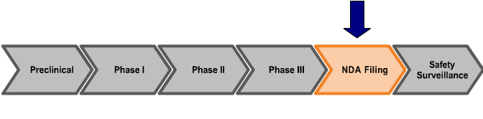
NDA/BLA Submission
FDA holds Pre-NDA meeting
  Identify pivotal studies
  Discuss methods of statistical analysis
  Uncover major unresolved issues
NDA includes all animal and human data from the development program
Notes:
If a drug developer has evidence from its early tests and preclinical and clinical research that a drug is safe and effective for its intended use, the company can file an application to market the drug. The FDA review team thoroughly examines all submitted data on the drug and makes a decision to approve or not to approve it.
A New Drug Application (NDA) tells the full story of a drug. Its purpose is to demonstrate that a drug is safe and effective for its intended use in the population studied.
A drug developer must include everything about a drug—from preclinical data to Phase 3 trial data—in an NDA. Developers must include reports on all studies, data, and analyses. Along with clinical results, developers must include:
Proposed labeling
Safety updates
Drug abuse information
Patent information
Any data from studies that may have been conducted outside the United States
Institutional review board compliance information
Directions for use

Slide 13
FDA Review
FDA determines the application’s completeness and assigns a review team to evaluate the application
FDA assesses
  Whether effectiveness has been demonstrated for the drug’s proposed use
  Whether the safety assessment is adequate to conclude that the drug is safe (i.e., the benefits of the drug outweigh the risks)
  Whether the manufacturing methods and the controls used to maintain the product quality are adequate
Advisory Committee input
Notes:
Once FDA receives an NDA, the review team decides if it is complete. If it is not complete, the review team can refuse to file the NDA. If it is complete, the review team has 6 to 10 months to make a decision on whether to approve the drug. The process includes the following:
Each member of the review team conducts a full review of his or her section of the application. For example, the medical officer and the statistician review clinical data, while a pharmacologist reviews the data from animal studies. Within each technical discipline represented on the team, there is also a supervisory review.
FDA inspectors travel to clinical study sites to conduct a routine inspection. The Agency looks for evidence of fabrication, manipulation, or withholding of data.
The project manager assembles all individual reviews and other documents, such as the inspection report, into an “action package.” This document becomes the record for FDA review. The review team issues a recommendation, and a senior FDA official makes a decision.
CMC “Pre-Approval” Inspection of manufacturing facility
FDA Approval
In cases where FDA determines that a drug has been shown to be safe and effective for its intended use, it is then necessary to work with the applicant to develop and refine prescribing information. This is referred to as “labeling.” Labeling accurately and objectively describes the basis for approval and how best to use the drug.
Often, though, remaining issues need to be resolved before the drug can be approved for marketing. Sometimes FDA requires the developer to address questions based on existing data. In other cases, FDA requires additional studies. At this point, the developer can decide whether or not to continue further development. If a developer disagrees with an FDA decision, there are mechanisms for formal appeal.
FDA Advisory Committees
Often, the NDA contains sufficient data for FDA to determine the safety and effectiveness of a drug. Sometimes, though, questions arise that require additional consideration. In these cases, FDA may organize a meeting of one of its Advisory Committees to get independent, expert advice and to permit the public to make comments. These Advisory Committees include a Patient Representative that provides input from the patient perspective. Learn more about FDA Advisory Committees.

Slide 14

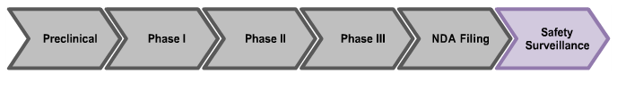
Post-Market Safety Surveillance
Knowledge about a product will always be limited at the time of approval
  Clinical studies are brief in duration and involve a limited patient population
  New safety information often emerges after a product is used in a wider patient population
FDA maintains an active program in post-market safety surveillance to monitor adverse events
Notes:
Even though clinical trials provide important information on a drug’s efficacy and safety, it is impossible to have complete information about the safety of a drug at the time of approval. Despite the rigorous steps in the process of drug development, limitations exist. Therefore, the true picture of a product’s safety actually evolves over the months and even years that make up a product’s lifetime in the marketplace. FDA reviews reports of problems with prescription and over-the-counter drugs, and can decide to add cautions to the dosage or usage information, as well as other measures for more serious issues.

Slide 15
So what exactly is FDA’s role?

Slide 16
Drug Development & Clinical Trials
FDA does not develop drugs
  Researchers, pharmaceutical companies, and nonprofit groups conduct disease research and drug development
FDA does not test drugs in clinical trials
  FDA does not run clinical trials
  FDA staff are not onsite for clinical trials
  Researchers conducting trials must seek FDA approval before beginning

Slide 17
Practice of Medicine & Drug Costs
FDA does not have authority to regulate the practice of medicine
  FDA regulates the development and marketing of medical products
  Doctors are free to prescribe FDA-approved drug for other conditions (known as “off-label” use)
FDA does not regulate the price of medicine
  Consideration of drug prices is not part of FDA’s mandate
  FDA cannot base an approval decision based on drug price
  FDA does not even receive pricing information during a review

Slide 18
FDA’s Role in Facilitating Drug Development
FDA’s mission includes “Promoting Public Health”
FDA reviewers have expert knowledge on drug development and clinical trials
  FDA provides technical help to researchers and drug developers
  FDA helps companies design clinical trials and studies
  FDA has numerous meeting with companies throughout the drug development process
Notes:
Drug developers are free to ask for help from FDA at any point in the drug development process, including:
Pre-IND application, to review FDA guidance documents and get answers to questions that may help enhance their research
After Phase 2, to obtain guidance on the design of large Phase 3 studies
Any time during the process, to obtain an assessment of the IND application
Even though FDA offers extensive technical assistance, drug developers are not required to take FDA’s suggestions. As long as clinical trials are thoughtfully designed, reflect what developers know about a product, safeguard participants, and otherwise meet Federal standards, FDA allows wide latitude in clinical trial design.

Slide 19
For more information on FDA regulation of medical products, as well as other ways to get involved, visit http://www.fda.gov/ForPatients/

Slide 20

Introduction to Patient-Focused Drug Development
Image used with permission of the FDA
Notes:
NOTE: The slides in this section cannot be edited as they were copied and pasted as images from FDA’s presentation.

Slide 21
Purpose of the Meetings?
FDA wanted a more systematic way to gather the patient perspective about the condition and available treatment options
Helps inform their understanding of the context for benefit/risk assessment and decision making for new drugs
Patient input helps the FDA during drug development and their review of an application for marketing a new drug

Slide 22
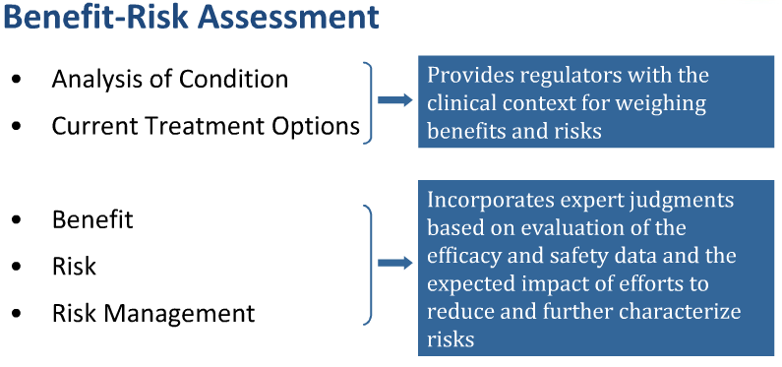

Slide 23
Familial Dysautonomia “Voice of the Patient” Meeting
Framework for discussion questions came from FDA’s benefit-risk framework; represents important considerations in their decision making
We reviewed this & other disease area questions and tailored our agenda/panel questions to communicate the most important information related to Familial Dysautonomia
FDA emphasizes that:
  ACTIVE PATIENT INVOLVEMENT & PARTICIPATION IS THE KEY TO THE SUCCESS OF THESE MEETINGS!

Slide 24
“Voice of the Patient” Report
The Familial Dysautonomia Foundation will prepare a written “Voice of the Patient” report after the meeting
  Summary of caregiver & audience testimony, polling data & submitted written comments
Key communication to FDA review staff & the regulated industry about what patients and caregivers most want to see in a treatment
FDA wants this information; informs them about ways to develop meaningful treatments for Familial Dysautonomia

Slide 25
Participating in the Meeting

Slide 26
Meeting Logistics
  Who?
    People with Familial Dysautonomia and caregivers, FDA staff, and pharmaceutical and biotech companies
When?
  November 5th, 2020 from 10:00 am – 3:00 pm EST
Where?
  Virtual Meeting (details will be coming!)
How?
  online via a live webcast

Slide 27
Overview of the Agenda
Welcome and introductory comments from Familial Dysautonomia Foundation, & FDA
Background on Familial Dysautonomia and clinical trials by Familial Dysautonomia expert
Broken into two topics:
  How Familial Dysautonomia symptoms affect your life
  How you manage symptoms and current & future approaches to treatment
Topics will include pre-recorded patient panels and will include polling questions and a moderated discussion with the audience
Closing comments

Slide 28
Discussion Questions
Topic 1: Living with Familial Dysautonomia: Disease Symptoms and Daily Impacts
Of all the symptoms of Familial Dysautonomia which 1-3 symptoms have the most significant impact on your life?
How does Familial Dysautonomia affect you on best and on worst days? Describe your best days and your worst days.
Are there specific activities that are important to you that you cannot do at all or as fully as you would like because of Familial Dysautonomia?
Notes:
This will help FDA understand what are clinically relevant endpoints
Give context: how long ago was your diagnosis made? But no need to tell entire story of diagnosis.

Slide 29
Discussion Questions (cont.)
Topic 1: Living with Familial Dysautonomia: Disease Symptoms and Daily Impacts
How have your symptoms changed over time?
  How has your ability to cope with the symptoms changed over time?
What do you fear the most as you get older?
  What worries you most about your condition?
  What frustrates you most about your condition?
Notes:
This will help FDA understand what are clinically relevant endpoints
Give context: how long ago was your diagnosis made? But no need to tell entire story of diagnosis.

Slide 30
Discussion Questions (cont.)
Topic 2: Current Challenges to Treating Familial Dysautonomia
What are you currently doing to manage your Familial Dysautonomia symptoms?
How well do these treatments treat the most significant symptoms of your Familial Dysautonomia?
What are the most significant downsides to your current treatments and how do they affect your daily life?
Short of a complete cure, what specific things would you look for in an ideal treatment for Familial Dysautonomia?
Notes:
This puts the disease in context and the clinical trial in context

Slide 31
Discussion Format
There will be a panel of patients for each panel
  The purpose is to set the foundation for the broader audience discussion
  Panelists are selected to reflect a range of experiences with the condition
Patients in the audience and online will have a chance to answer “polling” questions
  Their purpose is as a starting off point for the discussion
  Participants will use cell phones, tablets, or laptops to respond
Then move to a discussion with patients in the audience
  The purpose is to build on the experiences shared by the panel
  A moderator will ask questions and invite you to submit responses in writing or preferably, to call in to provide live comments
Notes:
Provide guidance on who should not participate.

Slide 32
Tips for Effective Participation
Remember FDA’s role & the purpose of the meeting
Review each Discussion Questions in advance
If you have something important to share, relate it to the most appropriate topic/panel question and call in!
It is okay to reiterate a feeling/experience already voiced by someone that is similar to your own, but give it a personal or unique perspective
Keep your comments concise & focused; there are many voices to be heard about this emotional topic
You can always send in additional comments after the meeting
Notes:
You are providing your perspective to FDA to help them help sponsors to design appropriate clinical trials and assess the information coming from those trials. This will help them make a judgement on the benefits and risks of a drug application. NOT to focus on issues of cost or what is going on in the doctor’s office. AND FDA will not be asking you to weigh in on any specific regulatory decision; this meeting is meant to set the context for future review.

Slide 33
Participating in the Discussion
Participate in the meeting:
  By webcast (remotely; polling questions, call in comments & written submissions)
  Responses will be kept confidential
Register for meeting:
  www.famdys.org/pfdd
  Comments with answers to the questions may be submitted for up to 30 days after the meeting
  Email responses to: pfddinfo@famdys.org
  These comments will be included in the “Voice of the Patient” report to be submitted to FDA

Slide 34
To attend the Live Webcast on November 5th
Please register in advance.
Register here:
  www.famdys.org/pfdd
  You will receive a log-in link on the day of the live webcast.

Slide 35
Participating in the Discussion
As a person living with FD or caregiver of someone with FD, would you like to be one of the panelists or a discussion starter for the meeting?
If yes, please register for the meeting by 7/24 (www.famdys.org/pfdd)
  On the registration form there will be a link to volunteer to be a panelist/discussion starter.
  When you volunteer, you will be asked to provide some information and to summarize your condition and treatment.

Slide 36
Questions? Need Assistance?
This webinar is being recorded and will be available online at: www.famdys.org/pfdd
If you have questions about participating, contact: pfddinfo@famdys.org

Slide 37
Summary
This is YOUR OPPORTUNITY to be part of the process
You can have a meaningful impact on clinical trial design & drug development
Your (collective) voices must be heard at the beginning of the process to help:
  companies design trials that meet your needs
  FDA assess risks & benefits with a full understanding of the impact of Familial Dysautonomia & the patient perspective
HELP MAKE A DIFFERENCE!!

Slide 38
Questions?
Please type your questions into the Chat

Slide 39
Please visit the meeting landing page to register:
Familial Dysautonomia
Voice of the Patient Forum:
Your Role in Drug Development
November 5th, 2020
www.famdys.org/pfdd

